Slide 1

Data Visualisation Coursework 1
UP2225522

Slide 2

Outline
Prototype 1 & 2
US toxic release

Slide 3

Prototype 1: Evolution of Basketball Offense & Analytics
UP2225522

Slide 4
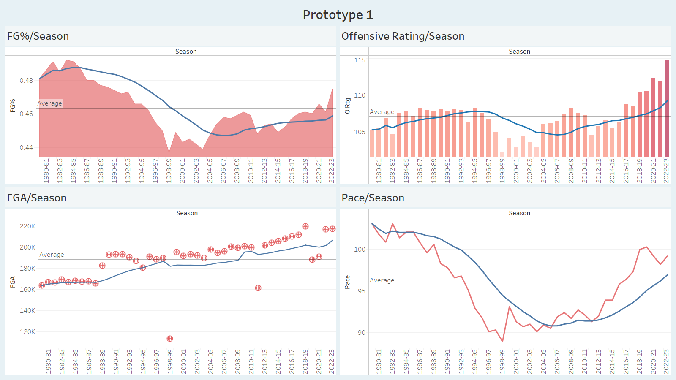

Slide 5
Definitions
Offensive Rating – A metric that measures a team's points scored per 100 possessions
Possessions - The number of possessions played by a player or team

Slide 6
Prototype 1: Conclusion
Traditional Metrics Limitations
Per Possession Insights
Increased Pace
Offensive Mastery
Increased Field Goals Attempt

Slide 7

Prototype 2: Influence of Basketball Analytics
UP2225522

Slide 8
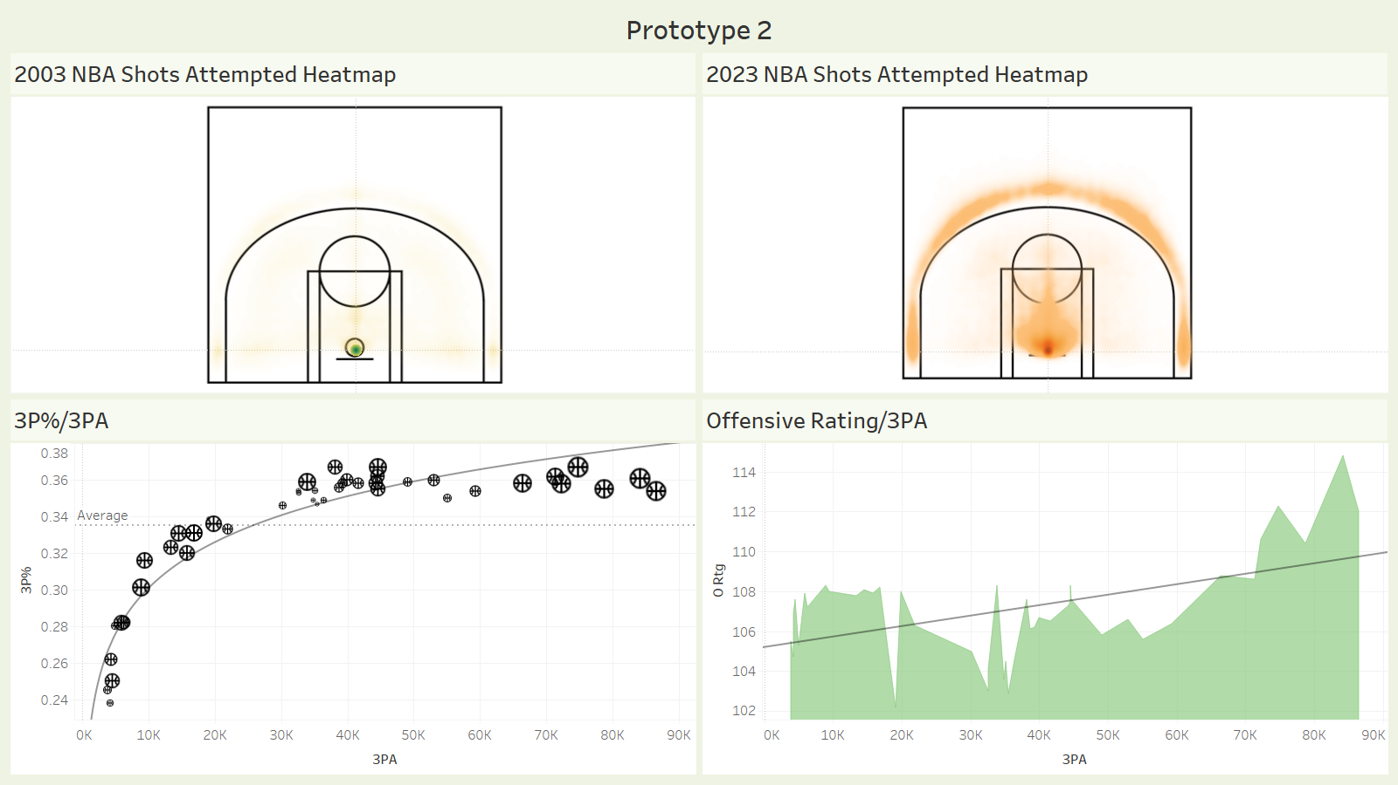

Slide 9
Prototype 2: Conclusion
Emphasis on close-range and 3-point shooting
More 3-point shooting correlates with better offence
Logarithmic relationship between 3-point percentage and attempts

Slide 10

US Toxic Release
UP2225522

Slide 11
Questions to answer
Which State had the highest pounds of releases and how much? (Rounded number)
Which State has the highest number of facilities and how many?

Slide 12
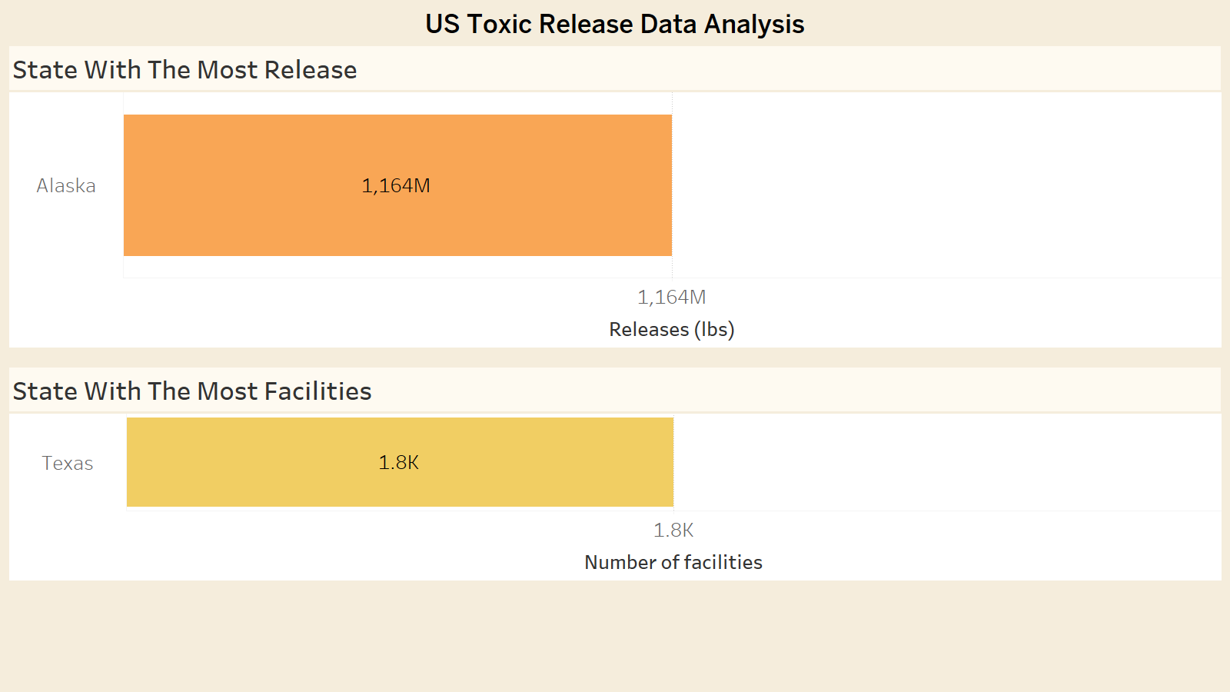

Slide 13

Imaginary Data Discussion
Carbon Emissions
PFAS Contaminations
Legacy of Conflict Pollution
Underreported Exposure

Slide 14
References
Mallinder, L. (n.d.). “Elephant in the room”: What is the US military’s carbon footprint? Al Jazeera. https://www.aljazeera.com/news/2023/12/12/elephant-in-the-room-the-us-militarys-devastating-carbon-footprint
NBA League Averages - Totals. (n.d.). Basketball-Reference.com. https://www.basketball-reference.com/leagues/NBA_stats_totals.html
Patel, S. (2020, September 6). swar/nba_api. GitHub. https://github.com/swar/nba_api
Perkins, T. (2023, October 13). Toxic PFAS from US military bases polluting drinking water, report finds. The Guardian. https://www.theguardian.com/environment/2023/oct/13/pfas-pollution-us-military-bases-forever-chemicals#:~:text=The%20military%20is%20considered%20one
‌Stat Glossary. (n.d.). ww.nba.com. https://www.nba.com/stats/help/glossary
Vartabedian, R. (2023, September 27). Decades Later, Closed Military Bases Remain a Toxic Menace. The New York Times. https://www.nytimes.com/2023/09/27/us/military-base-closure-cleanup.html
Venkatesan, N. (2020, June 17). Make a Simple NBA Shot Chart with Python. Medium. https://towardsdatascience.com/make-a-simple-nba-shot-chart-with-python-e5d70db45d0d
Verbeek, J. (2021, October 26). How to plot a Basketball Shot Chart using Tableau. The Data School down Under. https://www.thedataschool.com.au/joshua-verbeek/how-to-plot-a-basketball-shot-chart-using-tableau/

Slide 15
Python code to retrieve data for heat map
#%pip install nba_api
from nba_api.stats.endpoints import shotchartdetail
from nba_api.stats.static import teams
import json
import requests
import pandas as pd
nba_2023 = shotchartdetail.ShotChartDetail(
team_id=0,
player_id=0,
season_nullable='2022-23',
context_measure_simple = 'FGA',
season_type_all_star=['Regular Season', 'Playoffs']
)
nba2023_df = nba_2023.get_data_frames()[0]
nba2023_df
nba2023_df.to_csv('shot_chart_2023.csv', index=False)
nba_2003 = shotchartdetail.ShotChartDetail(
team_id=0,
player_id=0,
season_nullable='2002-03',
context_measure_simple = 'FGA',
season_type_all_star=['Regular Season', 'Playoffs']
)
nba2003_df = nba_2003.get_data_frames()[0]
nba2003_df
nba2003_df.to_csv('shot_chart_2003.csv', index=False)

